Slide 1
Uttoxeter U3A – Atomic and Nuclear Physics Session 5; Basic wave theory
A presentation by Dave Thomas
E: d.t.thomas@staffs.ac.uk
W: https://davethomaswebspace.org

Slide 2
What we could cover (in 90 minutes or so)
Today’s topics
Waves in general.
Why today’s topics?
Definitions of λ, ν (f), a, T.
Wave speed and graphical representation of waves.
Transverse and longitudinal waves.
Mechaninical and electromagnetic waves
Sound as a longitudinal wave
Light as a transverse wave (and more).
The ‘we have covered’ bit
Today’s and next week’s topics as a mind map
Your knowledge and questions as we go please
Notes:
Relativity, both Special (1905) and General (1916) were the result of ‘Gedankenexperimente’ ie thinking about it and were only ratified by observation years later (in the solar elclipse of 1919).

Slide 3
Waves in general
A wave is:
“A disturbance that travels through a medium.”
“a propagation of disturbances from place to place in a regular and organized way.” (Encyclopedia Britannics)
Like this transverse travelling wave pulse; ie one ‘wave’ and, on the face-of-it,
Like a number of pulses travelling together as a travelling\progressive wave
Like these transverse standing waves
NOT like these transverse water waves because they all break on the shore
rather these transverse water waves which don’t
And can be:
Lateral or longitudinal
Travelling or standing
Mechanical or electromagnetic
And . . . . . .
Notes:
The transmission medium does not travel; the individual particles of the transmission medium move in a plane at right-angles to the direction of travel of the wave. DRAW A PICTURE.

Slide 4
Why today’s topics
According to Einstein (again), a wave can exhibit particulate properties and vice versa! and we’ve been talking about particles; more of this ‘Wave-particle duality’ and ‘quanta’ later.
Waves are often drawn like this sinusoidal wave:
Notes:
W-p duality postulated because sometimes light displays particulate properties (moves in straihght lines)and sometime wave-like properties

Slide 5
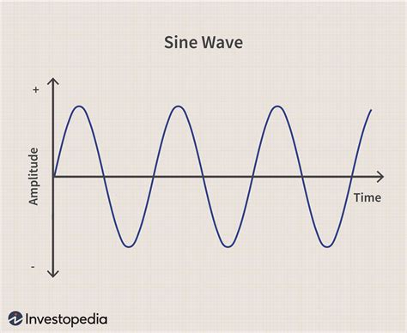
Definitions of λ (lambda), ν (nu),a, T.
peak
wavelength
trough
Notes:
Wavelength, frequency, amplitude, time period. Frequency = number of waves (oscillations) per second. Middle C = 256 cps = Herz. Sound is compression wave: DEMO with device. Mains electricity in UK = 50 Hz. Mains ‘hum’. T = 1\f.

Slide 6
Electromagnetic radiation (including light) ‘waves’
Light ‘waves’ are complicated!
Huygens considered light as a wave because:
Light reflects, refracts, diffracts and interferes
Its properties are well described by wave theory
BUT
Light also travels through a vacuum ie needs no transmission medium
Initiates electron emission in a particular way in the photoelectric effect
Einstein postulated light ‘quanta’

Slide 7
What we have covered in this session
Waves in general.
Why today’s topics?
Definitions of λ, ν (f), a, T.
Wave speed and graphical representation of waves.
Transverse and longitudinal waves.
Mechanical and electromagnetic waves
Sound as a longitudinal wave
Light as a transverse wave and more
All neatly summed up here
Any (further) things? Please let us know and\or share now and . . . . . . . . .
Notes:
Open discussion driven by the group on what sort pof things they’d like to explore. Must take notes!

Slide 8
Today’sand next week’s topics as a mind map
Back

