Slide 1
Uttoxeter U3A – Atomic and Nuclear Physics Session 4; (More) Properties of waves
A presentation by Dave Thomas
E: d.t.thomas@staffs.ac.uk
W: https://davethomaswebspace.org

Slide 2
What we could cover (in the next two sessions)
Sessions’ topics
Recap of last week’s topics
Principle of Superposition, interference.
Resonance
More on properties of waves:
Reflection, refraction, diffraction.
Phase considerations
More on resonance
Simple harmonic motion
Wave energy
The ‘we have covered’ bit
These and last week’s topics as a mind map
Your knowledge and questions as we go please

Slide 3
Recap of waves in general
A wave is:
“A disturbance that travels through a medium.”
“a propagation of disturbances from place to place in a regular and organized way.” (Encyclopedia Britannics)
often drawn like this sinusoidal wave; mapping the position of a component of the medium in which a wave moves
Wave speed = frequency * wavelength (v = fλ)
A wave is NOT
like these transverse water waves because they all break on the shore
A wave can be:
A pulse (think odd, blue puffer thing) or a continuous wave
Mechanical or electromagnetic
Lateral or longitudinal (think slinky)
Progressive or standing
Notes:
The transmission medium does not travel. In a transverse wave; the individual particles of the transmission medium move in a plane at right-angles to the direction of travel of the wave. DRAW A PICTURE.

Slide 4
Progressive wave fundamentals
A progressive wave transmits energy from one point to another; it DOES NOT move the transmission medium in the direction of the wave.
A pulse is one wave travelling through a medium
Like a Mexican wave!
Repeated pulses form a continuous wave
How frequently the wave repeats is its frequency (f) (in cycles per second, or Herz)
The distance between individual waves is the wavelength (λ)
λ
Notes:
Demo of Mexican wave in the classroom

Slide 5
Principle of superposition and interference
When two waves meet, the net resultant wave is the sum of both waves
Simplest case is waves of the same frequency, same amplitude
Phase of component waves is everything in defining the resultant waves

Slide 6
Reflection and refraction
Reflection occurs when a wave meets a change of transmission medium
Light travelling through air meets a mirror
Sound travelling through air meets a wall
Law of reflection states that:
the angle of incidence = angle of reflection (draw a picture Dave)
Phase of wave changes by 180° (π) when reflected

Slide 7
Phase considerations
The phase of wave (or other repeating cycle) is a measure (fraction) of how far along its repeating cycle it is
‘In phase’ means perfectly aligned
‘Out of phase’ means perfectly misaligned
Phase is measured as a fraction of a complete circle (in degrees or radians) so zero to 360 degrees or zero to 2π radians
Two ‘in phase’ waves interfere constructively
Two ‘out of phase’ waves interfere destructively.

Slide 8
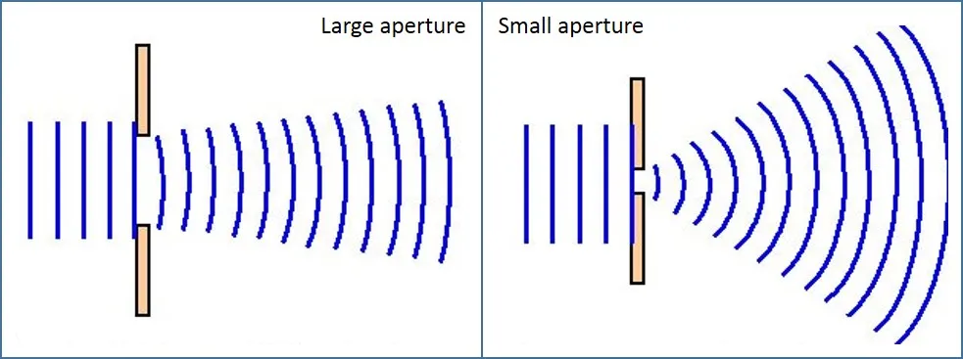
Diffraction
When a wave passes through a small aperture, it spreads out

Slide 9
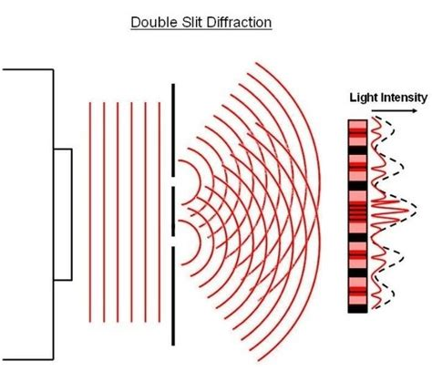
Multiple aperture diffraction
When a wave passes through multiple small apertures simultaneously:
The resultant waves interfere with each other

Slide 10
Wave energy
Wave energy (or energies!):
Mechanical Energy = Kinetic Energy + Potential Energy
Total Energy is proportional to the square of the wave amplitude
Total Energy is proportional to the inverse of the square of the distance from the source of the wave
Total energy of a wave is constant unless transferred to something else
Interference is interesting!

Slide 11
What we have covered in these sessions
Recap of last week’s topics
Properties of waves:
Phase considerations
Reflection, refraction, diffraction.
Wave energy
All neatly, if a little breathlessly, summed up here
Any (further) things? Please let us know and\or share now and . . . . . . . . .
Notes:
Open discussion driven by the group on what sort of things they’d like to explore. Must take notes!

Slide 12
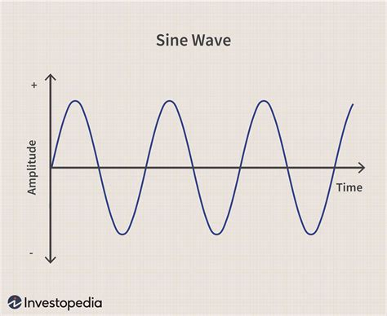
Definitions of λ (lambda), ν (nu),a, T.
peak
wavelength
displacement
trough
back
Notes:
Wavelength, frequency, amplitude, time period. Frequency = number of waves (oscillations) per second. Middle C = 256 cps = Herz. Sound is compression wave: DEMO with device. Mains electricity in UK = 50 Hz. 60Hz in US, Mains ‘hum’. T = 1\f.

Slide 13
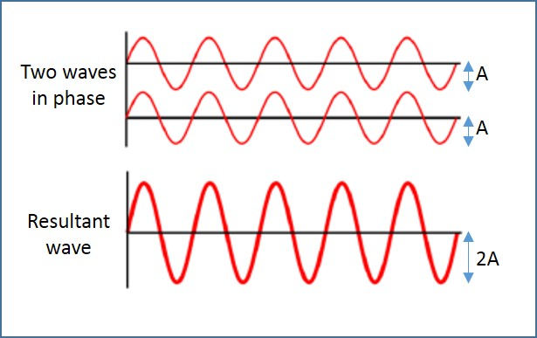
Two in-phase waves
Source: alevelphysics.co.uk
back

Slide 14
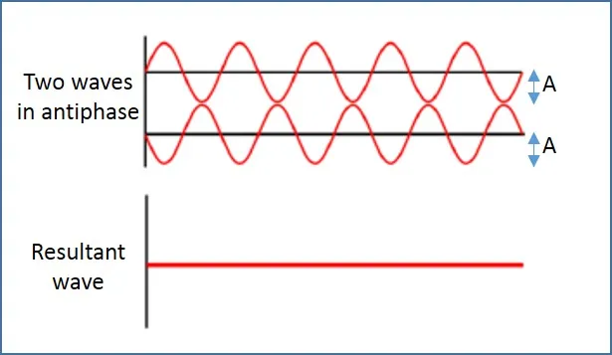
Two out of phase waves
Source: alevelphysics.co.uk
back

Slide 15
Today’s and next week’s topics as a mind map
Back

Slide 16
Resonance, open and closed pipes
Barton’s pendulum
Closed and open pipes
8’ organ pipe; middle C; 256 Herz
64’ organ pipe; 2 Herz

