Slide 1
Uttoxeter U3A – Atomic and Nuclear Physics Session 9; Nuclear Physics (1)
A presentation by Dave Thomas
E: d.t.thomas@staffs.ac.uk
W: https://davethomaswebspace.org

Slide 2
What we could cover
Sessions’ topics
Recap of previous topics
Wave theory
The photoelectric effect (and thus quanta)
Wave-particle duality (but possibly not in as much detail as Jenny would have done)
This time; Nuclear physics:
Nuclear physics generally
Fission reactions
Fusion reactions
Nuclear reactors
Particle physics will be mentioned!
The ‘we have covered’ bit
Nuclear physics topics as a mind map
Your knowledge and questions as we go please

Slide 3
Nuclear physics in general
Slide 3 of 10 or so
Nuclear physics is:
“the field of physics that studies atomic nuclei and their constituents and interactions, in addition to the study of other forms of nuclear matter.” (Wikipedia, 2022)
Fundamentally useful in its applications
Weird; with a capital ‘W’ (part of the ‘very small’ world at ~10⁻¹⁵m)
https://www.world-nuclear.org/information-library.aspx
Notes:
.

Slide 4
Nuclear fission reactions
In nuclear fission:
Large nuclei split into smaller nuclei (and particles\waves ~ enegy)
Spontaneously (as in U235) or in response to stimulation of some sort
Eg U-235 + n ===> Ba-144 + Kr-90 + 2n + about 200 MeV
LOTS of energy is produced\created (approx. 9x10¹⁶ J\kg of fissile material destroyed ~ )
‘Critical mass’ and ‘chain reaction’ are terms used
As are ‘thermal reactor’ and ‘fast breeder reactor’
It’s possible for things to go very wrong, very quickly like at Three Mile Island, Chernobyl and Windscale

Slide 5
Nuclear fusion
In nuclear fusion:
Smaller nuclei combine to create larger nuclei (and particles\waves)
Happens spontaneously, but only in the centre of stars; so far. Stars are very hot and exert massive pressure on their contents.
Eg 4H ===> 1 He
The same LOTS of energy is produced\created (approx. 9x10¹⁶ J\kg of material)

Slide 6
Nuclear reactors
Aim to use controlled nuclear reactions as a heat source to produce steam (from water) to drive rotating turbines
Fission reactors of different types exist (more to follow)
Fusion reactors of any type have yet to produce more energy than they use to create the energy they make; yet promise much!

Slide 7
Fission reactors
Usually use U235 to create a controlled chain reaction in the core of the reactor (U233 and Pu239 could work too)
The core is cooled by a coolant which transters the heat producedto (usually) water to create high pressure steam
Nuclear enery transferred to thermal energy and then to mechanical energy
Types of reactors:
thermal, fast breeder, PWR, LWR, HWR
https://www.nuclear-power.com/nuclear-power/fission/

Slide 8
Fusion reactors
Many possible technologies possibleto emulate stellar fusion including:
Tokomak (including JET, EAST, Tore Supra, etc) relies upon magnetic containment of fusing plasma
Inertia containment technologies including beam on beam, laser etc
Have yet to produce more energy than is consumed to maintain fusion
The world keeps trying, with hope.

Slide 9
Particle physics (starter)
Sub-atomic (and elementary\fundamemtal) particles discovered\observed\created especially at places like the LHC at CERN
Organised into ‘families’ of fermions and bosons in the ‘Standard Model’ arising from combinations of quarks and the like
Discovery of the Higgs Boson by the LHC in 2012 completed the model
So no surprise; there’ll be another one!

Slide 10
What we have covered in these sessions
Recap of previous topics
Wave theory
The photoelectric effect (and thus quanta)
Wave-particle duality
This time; Nuclear physics:
Nuclear physics generally
Fission reactions
Fusion reactions
Nuclear reactors
A brief look at elementary particles
Next time
Radioactivity and more on elementary particles
Any (further) things? Please let us know!
Notes:
Open discussion driven by the group on what sort of things they’d like to explore. Must take notes!

Slide 11
Today’s and next week’s topics as a mind map
Back

Slide 12
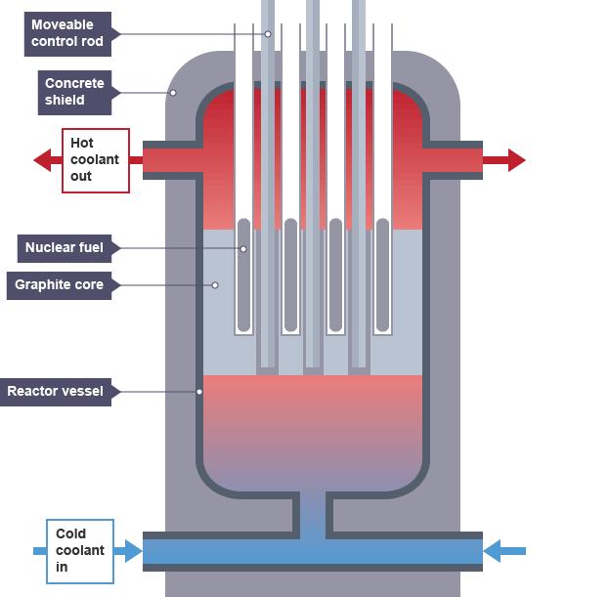
Schematic diagram of fission reactor (from https://www.bbc.co.uk/bitesize/guides/zyqnrwx/revision/2 )
back

Slide 13
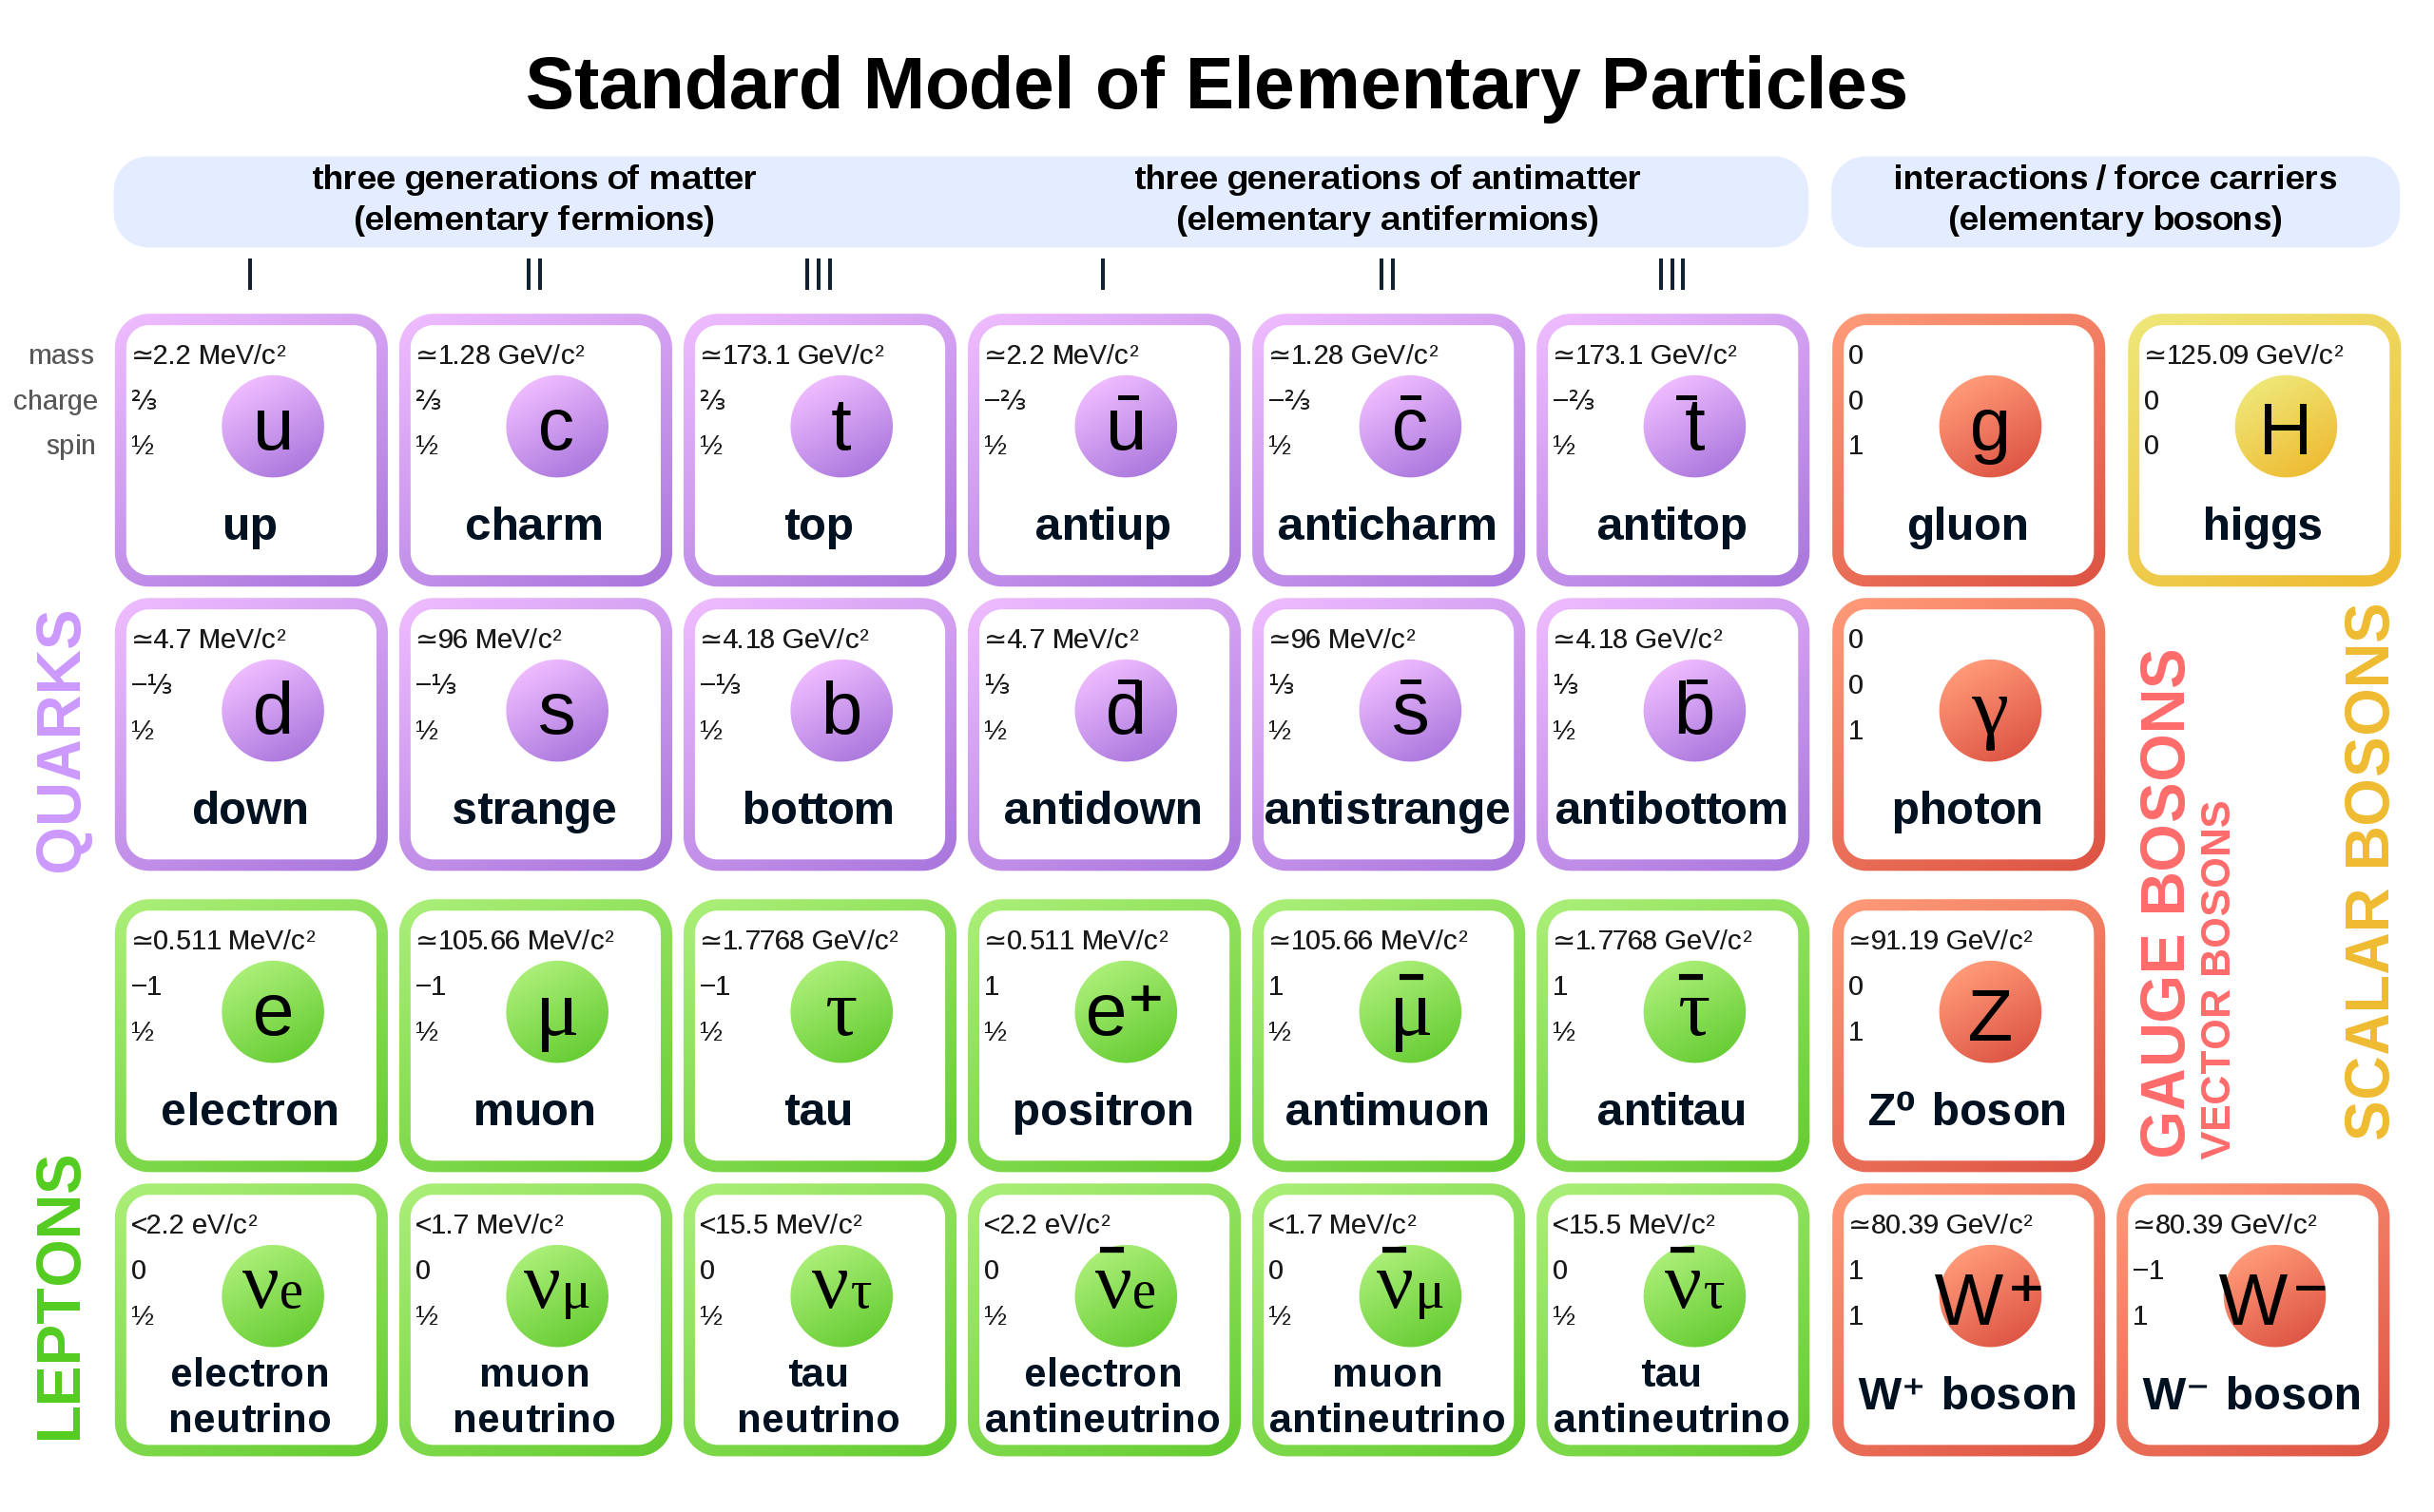
The Standard Model
back

