Slide 1
Uttoxeter U3A – The physics of everyday things
Current Electricy (ie elecricity in wires)
Learning with Dave Thomas
DaveInElderCourt@gmail.com
https://davethomaswebspace.org

Slide 2
What we could cover (in 90 minutes or so)
A brief resumé of what’s been mentioned so far
  An exploration of electricity
    What it actually is
    Static electricity; sparks, lightening and the like
This time and onward:
    Current electricity (electricity in wires)
      Current, voltage, resistance, circuits (and, and, and Ohm’s law)
      An analogy to understand the principles of these things
    Electricity, magnetism and motion
    Electricity generation in power-stations, hydroelectric plants, wind-turbines, solar panels and other devices
    Energy usage; . . . . . . . . . . .
  A quick look forward to further learning
    ‘Flight’ (with Jenny)
    Jet engines (with Simon)
    Other topics, tba
Your knowledge and questions as we go please

Slide 3
What is ‘electricity’ anyway?
Current electricity is:
  A movement of electrons’ energy from a –ve to a +ve terminal
  Can be constant (direct current) or varying (alternating current)
  Requires a source of energy to move (push) electrons (and their energy)
  Analogous to moving water (electrons\current) through a hosepipe. More water flows if the water pressure is higher and\or if the hosepipe is bigger,

Slide 4
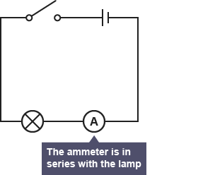
Electrical circuits
Current electricity flows only through complete circuits
Obeying Ohm’s law

Slide 5
Ohm’s law (1827)
Relates the voltage across a circuit to the resistance of the conductors and the current flowing
V = IR
Analagous to moving water (electrons\current) through a hosepipe; more water flows if the water pressure is higher and\or if the hosepipe is bigger.
Also, P = IV

Slide 6
Electricity, magnetism and motion
Magnetism, electricity and motion are inextricably linked (ask James Clark Maxwell and Hendrik Lorenz)
Electric motors use this, as do electric generators
The maglev train was once the UK’s great hope for future transportation and uses a linear induction (electric) motor for propulsion
The Shanghai maglev train in China regularly attains speeds of 260+ mph

Slide 7
Electricity generation
Generators simply do the same as motors, but backwards!
Rotary motion from an external power source is used to rotate coils in a magnetic field; producing alternating current
Could be:
  a power station like Rugeley B ,
  a portable generator
  a windmill
  a hydroelectric facility (like Ffestiniog)
Solar panels do things differently

Slide 8
What we have covered in this session
Current electricity
  Electricity in conductors
  Circuits
  Ohm’s law
  Electric motors
  Generation
  Not distribution
  Not many uses either!
Next time;
  An introduction to the principles of flight, then:
  Jet engines
‘Follow up’ learning materials at http://davethomaswebspace.org/U3A/SoeT/

Slide 9
The final words
Thank you!
It has been fun, so far.

Slide 10
Electric motors and generators
Use electromagnets to create magnetism in coils to create rotary motion
According to Lorenz’s law
Are very efficient (up to 96%), eco-friendly and the ‘in’ thing (even in F1) thanks to electric motor-cars
back

Slide 11
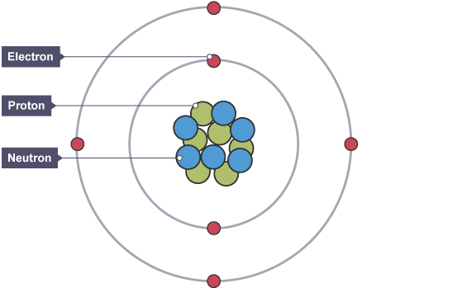
Structure of atoms
Source:BBCbitesize
back
Notes:
Electrons –vely charged
Nucleus 1/10,000 the size on the nucleus
Electron 1/1840 the mass of a proton

Slide 12
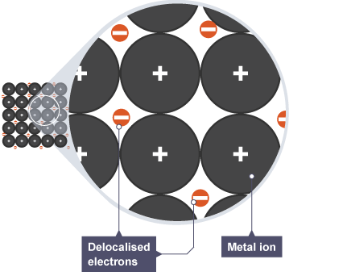
Structure of solid, metallic matter
Source:BBCbitesize
back

