Slide 1
Uttoxeter U3A – The physics of everyday things Electricy
Learning with Dave Thomas
DaveInElderCourt@gmail.com https://davethomaswebspace.org

Slide 2
What we could cover (in 90 minutes or so)
A brief resumé of what’s been mentioned so far
An exploration of what we might learn
A look at heat and what ‘hot’ means
Transfer(s) of energy
Rotary forces
This time and onward:
An exploration of electricity
What it actually is
Static electricity; sparks, lightening and the like
Current electricity (electricity in wires)
A quick look forward to possible further learning
Your knowledge and questions as we go please

Slide 3
What is ‘electricity’ anyway?
Electricity is:
One source of power that is used for:
Heating
Lighting
Cooling
Moving
Scaring people and animals almost out of their skins
Etc, etc, etc, etc
Increasingly expensive to buy
Naturally occurring and also manufactured by different means and distributed
Actually movement of charged, sub-atomic particles

Slide 4
Charged, sub-atomic particles
Remember the structure of atoms
Which identifies sub-atomic particles
And the structure of solid, metallic matter
Outer electrons in atoms can become ‘detached’ from their ‘home’ nuclei
So are readily moved remotely from them; either
physically (static)
Or
in a conductor with a electric field (current)
Notes:
Electrons –vely charged
Nucleus 1/10,000 the size on the nucleus
Electron 1/1840 the mass of a proton

Slide 5
Static electricity
Electrons are physically moved from one place to another:
by rubbing different materials together and then separating them
by powder flowing through tubes
by using a van de Graaf generator
when walking across and acrylic carpet
by raindrops in thunder clouds
And more
Very high charges (and voltages)can be built up
Notes:
3,000,000 V per m’ breakdown potential of air
Falling hail and ice liquifies on outside of droplet and collects electrons as it falls. Tops of clouds become +ve, bases –ve.
1 electron carries 1.6 @ 10^-19 Coulombs
Voltage = electrical ‘pressure’, current = electrical ‘flow’

Slide 6
What we have covered in this session
Fundamentals of electricity; moving charges
The structure of materials and atome
Static electricity
Charge, voltage, current and onwards
Anything eolse you’d like to cover?
Next; current electricity
Electricity in conductors; generation, distribution, use, Ohm’s law,
Notes:
Open discussion driven by the group on what sort pof things they’d like to explore. Must take notes!

Slide 7
The final words
Thank you!
It has been fun, so far.

Slide 8
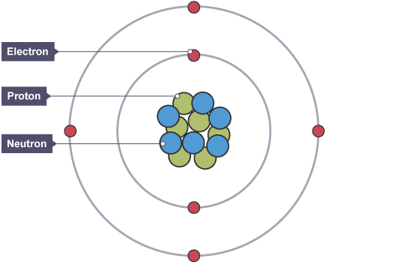
Structure of atoms
Source:BBCbitesize
back
Notes:
Electrons –vely charged
Nucleus 1/10,000 the size on the nucleus
Electron 1/1840 the mass of a proton

Slide 9
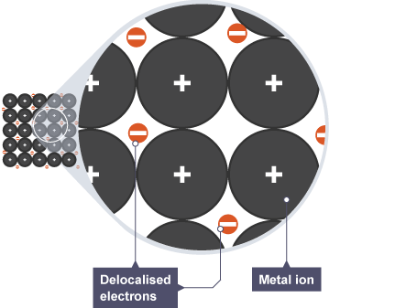
Structure of solid, metallic matter
Source:BBCbitesize
back

