Slide 1
Uttoxeter U3A – The physics of everyday things Sound, noise and music (part 2)
Learning with the U3A with Dave Thomas
DaveInElderCourt@gmail.com https://davethomaswebspace.org

Slide 2
What we could cover (in 90 minutes or so)
A brief resumé of what’s been mentioned so far
An exploration of the physics of music:
Sound, noise and music which are mostly
Vibrations and waves
Different families of musical instrument
This time and onward:
More on different families of musical instrument
How to make sound with each type of instrument
Brass, woodwind, stringed, pipes
The physics of musical scales
Octaves, scales and the like
A quick look forward to further learning
Other topics, tba
Your knowledge and questions as we go please

Slide 3
Different families of musical instruments
Stringed instruments (vibrating string(s) of varying length)
Violin, viola, cello, double bass, guitar. Banjo, ukulele, harp(s) etc
Brass instruments (open end pipes, mouthpiece vibration, variable length of pipe)
Trumpet, trombone, tuba, E♭ bass, B♭ bass, euphonium etc)
Woodwind (open end pipes, reed (or orifice) vibration, holes in body)
Picolo, flute, recorders etc AND a motor car with an open sunroof
Reed instrumants (vibrating reed and an open pipe)
clarinet, oboe, bassoon, saxaphones etc
Percussion (tuned or not; hitting things)
Drums, xylophone, glockenspiel, triangle etc
Keyboard (piano {string}, organ {open and closed pipes},
accordian (reed), harpsicord {string}, harp {string} etc)
Weird. The theremin; really weird when performing ‘Ocean’
Your knowledge and questions as we go please

Slide 4
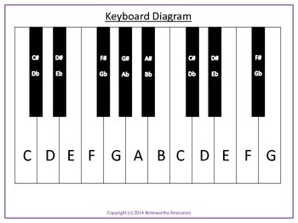
The physics of musical scales
A major scale is 7 (or 8) notes (12 semitones) to an octave; like this
An octave doubles (or halves) the frequency of the sound

Slide 5
Notes (intervals between them) in a scale
A major scale’s intervals ALWAYS go:
Note Note Note Note Note Note Note Note
Tone, tone, semitone, tone, tone, tone, semitone
The frequency ratios and frequencies go:
Note Note Note Note Note Note Note Note
1 9/8 5/4 4/3 3/2 5/3 15/8 2
256 320 384 512

Slide 6
Resonant lengths
Scale
Note Note Note Note Note Note Note Note
1 9/8 5/4 4/3 3/2 5/3 15/8 2
256 320 384 512
Resonant length of vibrating element
1 8/9 4/5 3/4 2/3 3/5 8/15 ½
A string is simply ‘stopped’ to shorten it (demo)
A pipe\tube is more complicated

Slide 7
Shortening the resonant of a tube\pipe
When all holes on a recorder are covered, the air column length = instrument length
Frequency = 330/length*2 (f/λ)
Frequency = 330/0.5 = 660Hz
https://www.flute-a-bec.com/acoustiquegb.html

Slide 8
What we have covered in this session
Different families of musical instrument and how they make sounds
Some physics of music scales and notes
Next time(s);
To be discussed (possibly from this)
‘Follow up’ learning materials at http://davethomaswebspace.org/U3A/SoeT/ and there are lots of links in this presentation

Slide 9
The final words
Thank you!
It has been fun, so far.

Slide 10
12 semitones to an octave
An octave is doh to doh (as in doh, ray, me, fah, soh, lah, te, doh.)
Intervals between notes not always the same
back

Slide 11
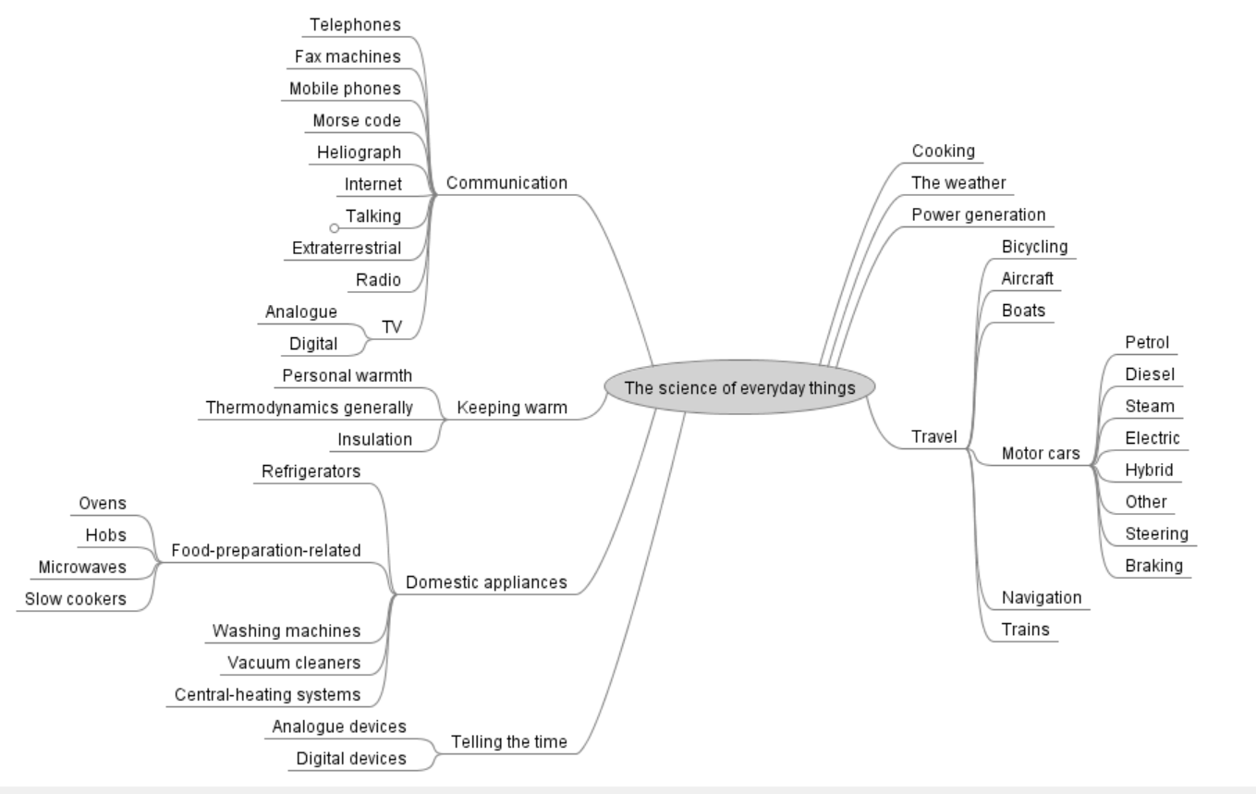
Possible things we could learn about
back

Slide 12
References
Chambers, 2014, The Chambers Dictionary, 13th Edition, Chambers Harrap, London.
Hodges, 2009, The musical scale and its intervals, on line at https://www.richardhodges.com/MusicalScale.htm on=line, accessed on 28th November, 2022.
https://www.allaboutmusictheory.com/major-scale/ on-line, accessed 29th November, 2022.

