Slide 1
Uttoxeter U3A – The physics of everyday things Sound, noise and music
Learning with the U3A with Dave Thomas
DaveInElderCourt@gmail.com https://davethomaswebspace.org

Slide 2
What we could cover (in 90 minutes or so)
A brief resumé of what’s been mentioned so far
An exploration of:
Thermodynamics (heat)
Atomic structure and electricities
Forces, flight and jet engines
This time and onward:
Sound, noise and music which are mostly
Vibrations and waves
Different families of musical instrument
A quick look forward to further learning
Other topics, tba
Your knowledge and questions as we go please

Slide 3
Sound, noise and music?
Sound is:
1 physics periodic vibrations that are propagated through a medium, eg air, as pressure waves, so that the medium is displaced from its equilibrium state. 2 the noise that is heard as a result of such periodic vibrations. (Chambers, 2014)
Noise is:
1 a sound. 2 a harsh disagreeable sound, or such sound; a din.
Music is:
1 the art of making sound in a rhythmically organised, harmonious form, either sung or produced with instruments, and usually communicating some idea or emotion. 2 such sound, especially that produced by instruments. (Chambers, 2014)

Slide 4
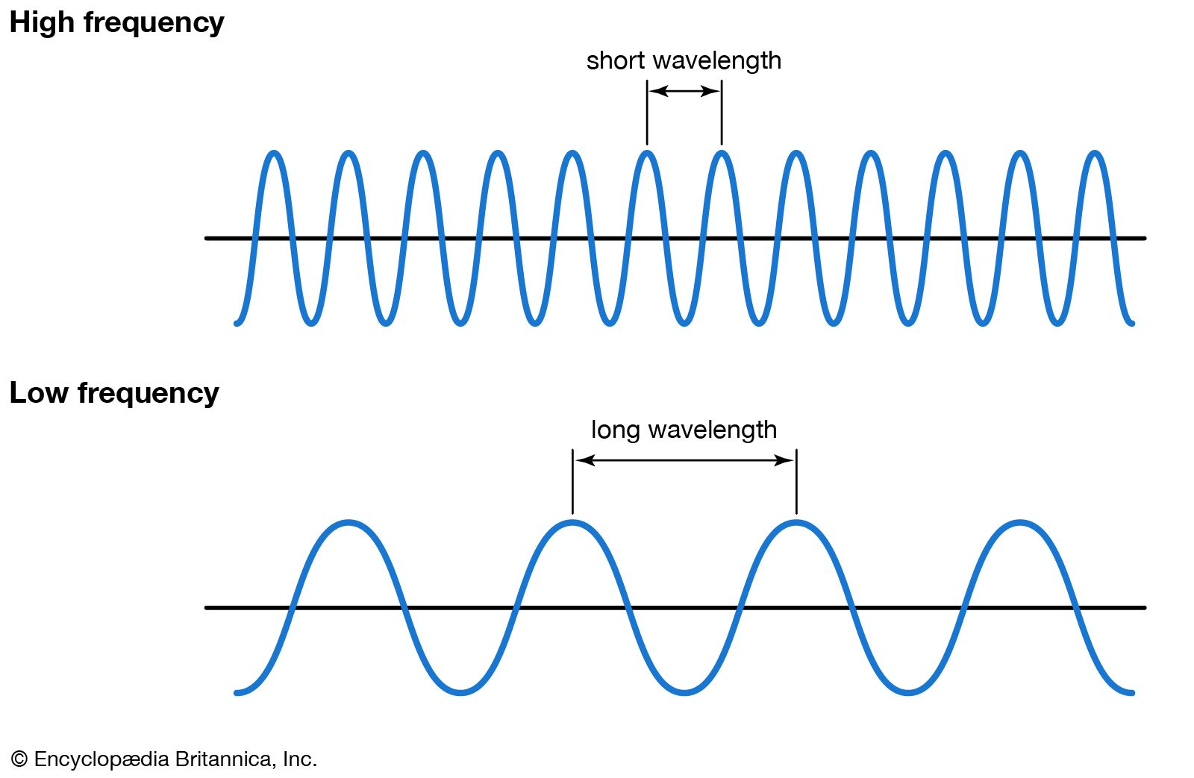
Sound as a wave
The physics of musical sounds; vibrations and waves
Waves generally (standing and travelling)
C=λν (or v = fλ)
ν (f) ≈ pitch of a note
Waves in strings
Open strings and frequency
Stopped strings
Waves in pipes
Open pipes
Closed pipes
Notes:
C=λν
and

Slide 5
Different families of musical instruments
Stringed instruments (vibrating string(s) of varying length)
Brass instruments (open pipes, mouthpiece vibration, variable length of pipe)
Trumpet, trombone, tuba, E flat bass, B flat bass, euphonium etc)
Woodwind (closed pipes)
Picolo, flute, recorders etc
Reed instrumants (vibrating reed and closed pipe)
clarinet, oboe, bassoon, saxaphones etc
Percussion (tuned or not; hitting things)
Drums, xylophone, glockenspiel, triangle etc
Keyboard (piano, organ, accordian etc)
Weird
The theremin which is really weird when performing ‘Ocean’
Your knowledge and questions as we go please

Slide 6
What we have covered in this session
Sound, noise and music which are mostly
Vibrations and waves
Different families of musical instrument
Next time;
To be discussed (possibly from this)
‘Follow up’ learning materials at http://davethomaswebspace.org/U3A/SoeT/

Slide 7
The final words
Thank you!
It has been fun, so far.

Slide 8
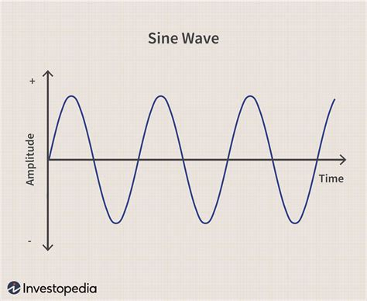
A generic (sine) wave: λ (lambda), ν (nu), a, T.
peak
wavelength
trough
back
Notes:
Wavelength, frequency, amplitude, time period. Frequency = number of waves (oscillations) per second. Middle C = 256 cps = Herz. Sound is compression wave: DEMO with device. Mains electricity in UK = 50 Hz. Mains ‘hum’. T = 1\f.

Slide 9
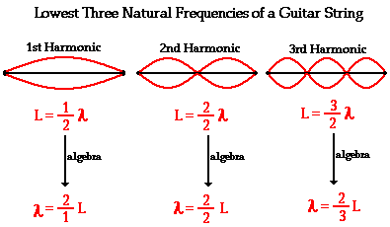
Waves in open strings
The magical relationship between frequency and octaves (and thus scales)
back

Slide 10
Resonant frequency of a vibrating string
C=λν ( C = lambda * nu) in other symbols
is
v = fλ (velocity, v = frequency, f * lamda)
and v = √T/μ
back
Notes:
Draw a vibrating string!

Slide 11
Waves in pipes
Draw pictures David!
Back

Slide 12
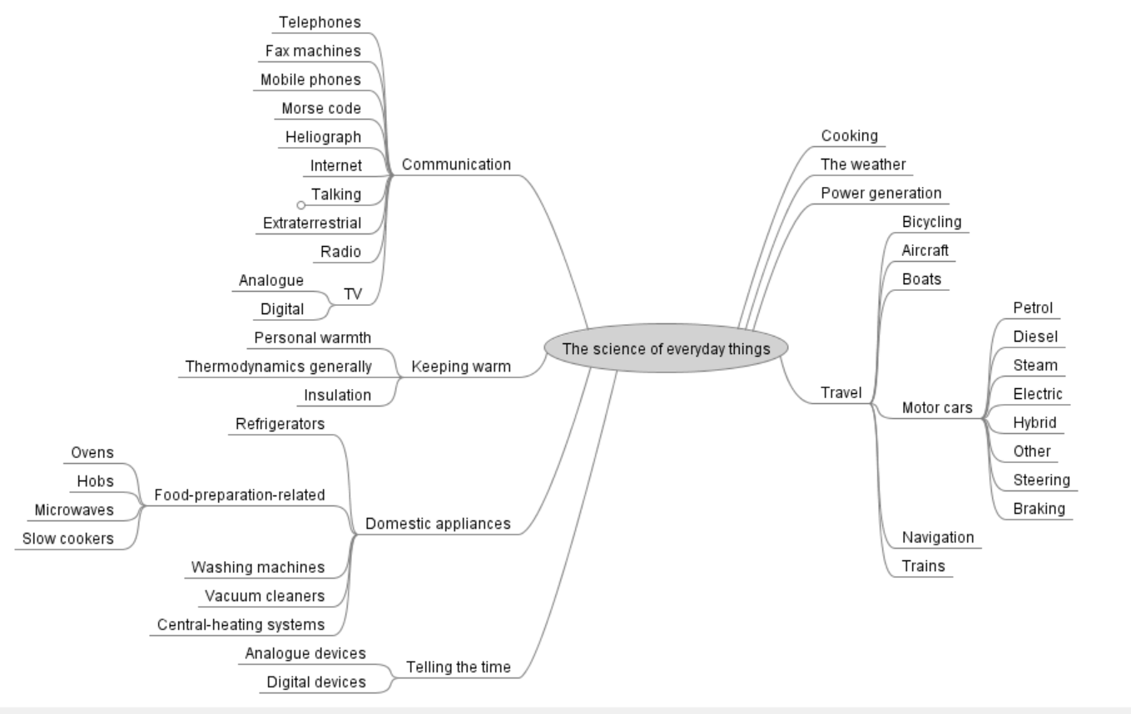
Possible things we could learn about
back

Slide 13
References
Chambers, 2014 Chambers 21st Century Dictionary, 13th Edition, Chambers, Edinburgh.

