Slide 1
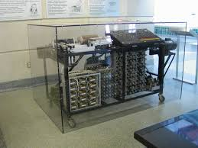
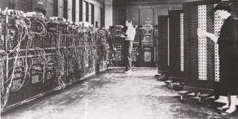
The first mechanical computer was invented by Charles Babbage in 1822
Due to lack of funding Charles was not able to complete a full scale version of the machine in his lifetime.
In 1991, a fully functioning engine was built from Babbage's original plans and is on display on in the London Science Museum.
ABC Computer
Invented by Atanasoff-Berry between 1937 – 1942.
This was an automatic electronic digital computer, and was capable of doing complex linear equations.
ENIAC computer
Invented by John Presper Eckert & John Mauchly between 1943 and 1946.
ENIAC was a general purpose electronic digital computer.
It was called the large brain & was the size of a large room and weighed 50Tons.
US Federal Judge Earl R. Larso declared that Atanasoff-Berry was the first inventor of the electronic digital computer.

Slide 2
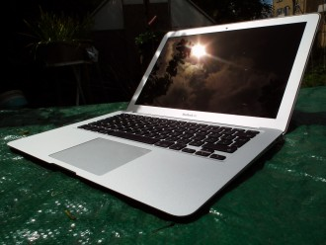
The Apple MacBook Air was rated by Which to be number one best computer for 2014
The Apple MacBooks have not changed very much over the last five years.
They have an above average reliability and a customer satisfaction overall of 94%.
It is lightweight, and the resolution, colour definition is superb.
Processing capability and speed is an impressive 1.6GHz Intel Core i5-4260U dual-core processor,
The Apple MacBook Air

Slide 3
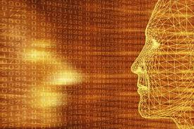
Within the next 50 years technology will have developed so much.
In 2010 the top speed of a computer processor was 5.2 GHz.
Moore’s Law predicts that the processing speed doubles every two years.
2050 engineers could produce a processing speed capable of running at 5,452,595 gigahertz, or nearly 5.5 petahertz.
This could result in Complex computations resulting in virtual simulations.
It is predicted that in 50 years the human mind will be able to connect to a computer, this could make you the perfect person.
The world will change and develop to the point where, nothing will be unimaginable. Cars will drive themselves under your instruction, to your desired destination. No more accidents or deaths on our roads.

Slide 4
First week pre-arrival activities
Presentation By Miss Jackie Hollyoak
Foundation Year in Computing & Mathematics

