Slide 1
Uttoxeter U3A - Introduction to Cosmology Session 10; Life in the universe
A presentation by Dave Thomas
d.t.thomas@staffs.ac.uk
https://davethomaswebspace.org

Slide 2
What we could cover (in 90 minutes or so)
A brief resumé of what’s been mentioned so far
Stars; formation, life and death
Different types of stars, fusion and deaths (with uncle Brian)
This time; Life in the universe
What is ‘life’
The search for life in the universe
Missions within solar system
Exoplanets and evidence
SETI by signal interception
The Fermi paradox
The Drake Equation and ‘Dark Forest’theory
What you wish to know\share
A quick look forward to next week
Your knowledge and questions as we go please

Slide 3
What is ‘life’?
‘Life’ is:
Difficult to define:
In Plato’s opinion there is vegetable, animal and rational ‘life’
In high-school biology it is something that:
Metabolises
Grows
Reproduces
Responds to its environment
The Glasgow Coma Scale score is used in A&E
NASA’s definition is broad and their current SETI people refuse to define it categorically

Slide 4
The search for life in the universe
Three ‘prongs’ of search for life
Direct search on the surfaces of near planetary objects; eg Moon rocks (381Kg from Apollo missions). Mars Curiosity (2012) and Perseverence (2020) rover, etc.
Observation of exoplanets
Classic ‘SETI’; listening for signals from space (LGM) in the radio and microwave spectrum. I was an eager participant in SETI@home (and more here)using data from the Arecibo Observatpry

Slide 5
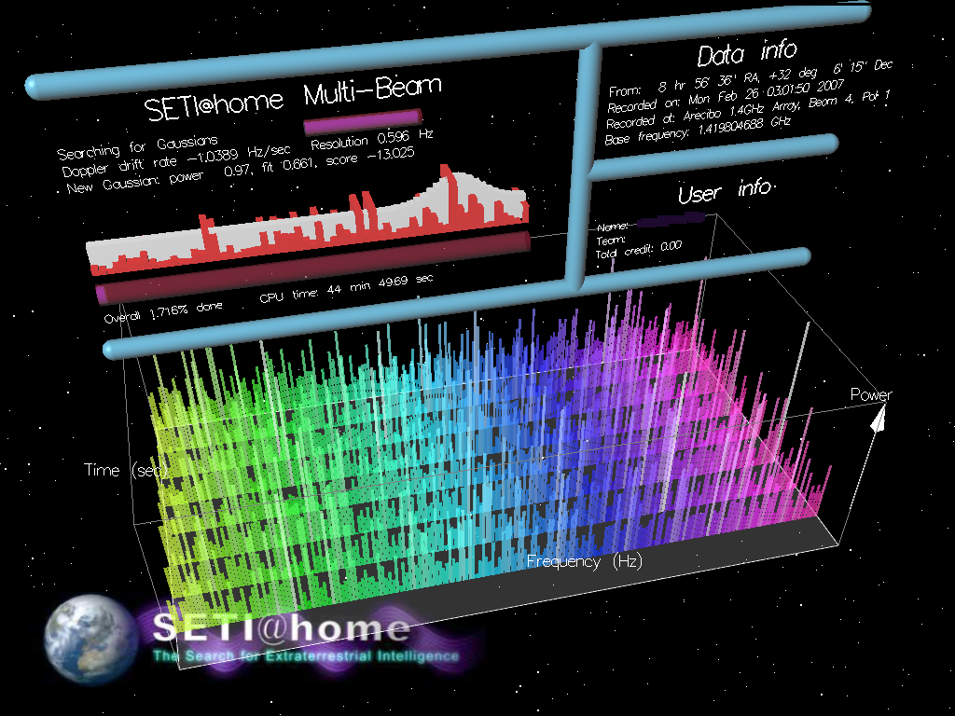
The SETI@home screen saver

Slide 6
The Drake equation the Fermi paradox and the Dark Forest Theory
The Drake Equation;
Combines all the factors pertaining to ‘contact’ with\from extraterrestial life.
N : The number of civilizations in the Milky Way galaxy whose electromagnetic emissions are detectable.
R* : The rate of formation of stars suitable for the development of intelligent life (number per year).
f_{p} : The fraction of those stars with planetary systems.
n_{e} : The number of planets, per solar system, with an environment suitable for life.
f_{l} : The fraction of suitable planets on which life actually appears.
f_{i} : The fraction of life bearing planets on which intelligent life emerges.
f_{c} : The fraction of civilizations that develop a technology that produces detectable signs of their existence.
L : The average length of time such civilizations produce such signs (years).

Slide 7
The Fermi paradox and the Dark Forest Theory
The Fermi paradox, If there are all the alien intelligences in our own milky way, let alone the universe, where are they all?
The Dark Forest Theory (as described by Cixin Liu); in a dark forest, if you her someone you don’ know call your name, do you reply or do you stay silent?

Slide 8
What we have covered in this session
How stars form
‘Living’ stars and their variety
How stars may die
A quick look forward to next week
Any (further) things? Please let us know and\or share now

Slide 9
Next week
Einstein and his special and general theories of relativity
Anything else you might like to explore

Slide 10
Exoplanets
As of 2 March 2022, there are 4,980 confirmed exoplanets in 3,670 planetary systems, with 813 systems having more than one planet.^{[5]}
There are many methods of detecting exoplanets. Transit photometry and Doppler spectroscopy have found the most, but these methods suffer from a clear observational bias favoring the detection of planets near the star; thus, 85% of the exoplanets detected are inside the tidal locking zone.^{[6]} In several cases, multiple planets have been observed around a star.^{[7]} About 1 in 5 Sun-like stars^{[a]} have an "Earth-sized"^{[b]} planet in the habitable zone.^{[c][8][9]}
Assuming there are 200 billion stars in the Milky Way,^{[d]} it can be hypothesized that there are 11 billion potentially habitable Earth-sized planets in the Milky Way, rising to 40 billion if planets orbiting the numerous red dwarfs are included.^{[10]} (Wikipedia, accessed 23rd March 2020) Back

