Slide 1
Uttoxeter U3A - Introduction to Cosmology Session 3 – Modern Cosmology
A presentation by Dave Thomas
d.t.thomas@staffs.ac.uk
https://davethomaswebspace.org

Slide 2
What we could cover (in 90 minutes or so)
Link between observed phenomena and cosmology theories
‘Modern’ Cosmology includes:
Microwave background (MWB) radiation considerations
The Big Bang origin theory with consideration of distinct phases after the Big Bang
Dark matter
Dark energy
Other, really cooky stuff
The ultimate fate of the universe
Is modern cosmology actually avant-garde witch-craft?
Your knowledge and questions as we go please

Slide 3
Cosmology generally
To reiterate, Cosmology is:
“A field of study that brings together the natural sciences, particularly astronomy and physics, in a joint effort to understand the physical universe as a unified whole”. (Encyclopedia Britannica, 2021)
the study of the universe's origin, its large-scale structures and dynamics, and the ultimate fate of the universe, including the laws of science that govern these areas. (Wikipedia, 2021).
The search for answers; other than ‘42’, to the ultimate question (Adams, 1978)

Slide 4
Link between observed phenomena and Cosmology theories
Up to 1609 all astronomical observation done of visible light, with the naked eye
1932; first radio signals detected from space
1942; radio waves detected from our sun
1949; first extra-galactic radio waves detected from the Crab Nebula; the remnant of the 1054 supernova
1965; Cosmic Microwave Background observed
1968; First pulsar observed by Jocelyn Bell Burnell
1974; Penrose and Hawking predict Black Holes
1990; Hubble orbiting space telescope launched
1993; Hubble space telescope starts to work well
2012; First visual observatyion of a Black Hole
2016; LIGO detects first gravitational waves

Slide 5
Current beliefs; the Lambda-CDM model
Origin Theory
Big bang then many phases\epochs
Inflationary epoch (0 to 10⁻³²s)
Opaque plasma
Plank era (off the scale, cooky era new defunct!)
Very early universe (10⁻³² s to 10⁻⁶ s)
Recombination era, CNB formed
Up to 1 minute; elementary particles combine
2 minutes to 20 minutes; nuclear fusion forms heavier elements as an opaque plasma
20 minutes; nuclear fusion stops as universe cools
18,000 years
370,000 years
Afterglow ( )
Dark ages

Slide 6
Current beliefs; the Lambda-CDM model
Current state of the universe could be:
either static, expanding or contracting; even Einstein changed his mind
Contains three things only:
Energy (Lambda)
Dark matter
Ordinary matter
Edwin Hubble and CMB says:
It is now expanding and at an accelerating rate; driven by ‘dark energy’
Only 6% of universe is visible ‘ordinary’ matter
Has no centre and no edge
Ultimate fate

Slide 7
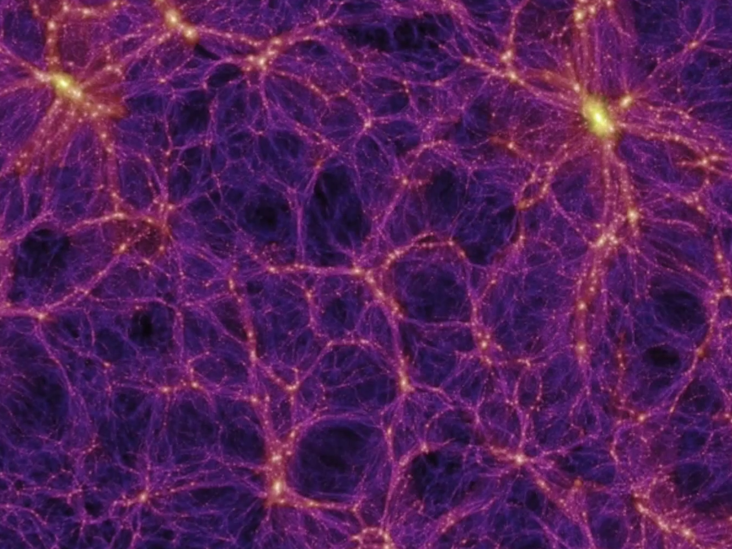
Current beliefs on current structure of the universe
http://static.businessinsider.com/image/540795c769bedd7653fb7891

Slide 8
Current beliefs on the fate of the universe
Big rip?
Big crunch?
Big bounce?
Big chill?
Subject of intense debate and current research (eg with Supernova Cosmology Project)
Discussed here
Altogether, an infographic to die for

Slide 9
What we have covered in this session
Cosmology generally
Link between observed phenomena and cosmology theories (1609 cusp point)
The Big Bang origin theory
Current structure and dynamics theories
Possible fates of the universe
Implications of things we still need to know
Any (further) things? Please let us know
Like these

Slide 10
Further learning
Video on the Big Bang theory of the origin of the universe
The large-scale structure of the universe; five lectures from Oxford University
http://www-astro.physics.ox.ac.uk/~astroc1/Lectures_files/LSS1.pdf
Quantum Gravity (not for the faint-hearted
Back
any (more) knowledge and\or questions?

Slide 11
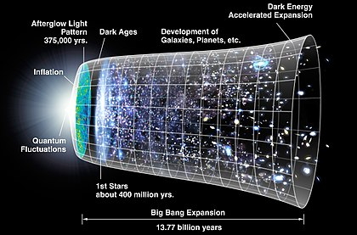
Timescale of events in the formation of the universe
back

