Slide 1
Uttoxeter U3A - Introduction to Cosmology Session 8 – Introduction to Stars
A presentation by Dave Thomas
d.t.thomas@staffs.ac.uk
https://davethomaswebspace.org

Slide 2
What we could cover (in 90 minutes or so)
A brief resumé of what’s been mentioned so far
What stars are; generally
How stars form
‘Living’ stars
Different characteristics
Observed colour
Brightness
Size
Spectral signature
Etc
A quick look forward to next week:
More on star characteristics
How stars die
Your knowledge and questions as we go please

Slide 3
Cosmology generally
To reiterate, Cosmology is:
“A field of study that brings together the natural sciences, particularly astronomy and physics, in a joint effort to understand the physical universe as a unified whole”. (Encyclopedia Britannica, 2021)
the study of the universe's origin, its large-scale structures and dynamics, and the ultimate fate of the universe, including the laws of science that govern these areas. (Wikipedia, 2021).
The search for answers; other than ‘42’, to the ultimate question (Adams, 1978)

Slide 4
What we have covered in previous sessions
Earlier topics in Cosmology generally:
Historical cosmological theories
Modern cosmology
The solar system
Observational astronomy
The milky way and galaxies generally
All lead us to stars
Any (further) things? Please let us know

Slide 5
What a star is
an astronomical object comprising a luminous spheroid of plasma held together by its own gravity.
Plasma is a mixture of charged particles (electrons and ions), is conductive and can behave like a gas but is not a gas.
Plasma is the most common state of matter in the universe (99.9% of all observable matter in the universe is plasma (NASA, 1999)
A typical atom is 50,000 larger than its nucleus.
If the earth were a typical atom, the nucleus would be 260m in diameter
Remember this when considering plasma!

Slide 6
Properties of stars
Stars:
Form from interstellar hydrogen and dust
Shine and are thus readily visible
Have gravity
Can be huge; our sun is used as a yardstick for other stars. KY Cygni is 1500 times bigger than our sun
Our sun:
is 109 times larger in diameter than the Earth at 1.6 million kilometres
is 330,000 times as massive as the Earth at 2x10³⁰ Kg
turns 4 million tons of matter into energy PER SECOND
is a balance of gravitation trying to collapse it and the pressure from nuclear fusion trying to inflate it

Slide 7
Living’ stars generally
Different characteristics
Observed colour (and hence temperature of outermost, visible layer of star)
Brightness (related to size)
Size
Spectral signature
Variation of particular characteristic
More on these things next week

Slide 8
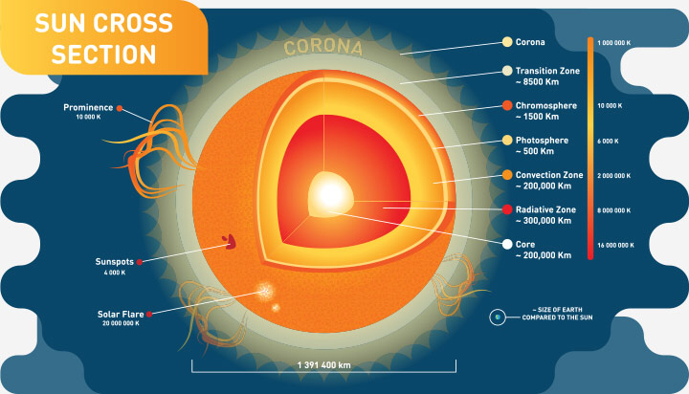
Structure of a (THE) star

Slide 9
What we have covered in this session
What stars are; generally
How stars form
‘Living’ stars
Different characteristics
Observed colour
Brightness
Size
Spectral signature
Etc
A quick look forward to next week
Any (further) things? Please let us knownand\or share now

Slide 10
Further learning and references
Millis, John P., "Going Inside a Star to See How It Works." ThoughtCo, Dec. 23, 2021, thoughtco.com/what-is-a-star-3073608. Accessed 7th March 2022.
Hawking, S., “A Brief History of Time”, 1988, Cambridge University Press.
Back
any (more) knowledge and\or questions?

Slide 11
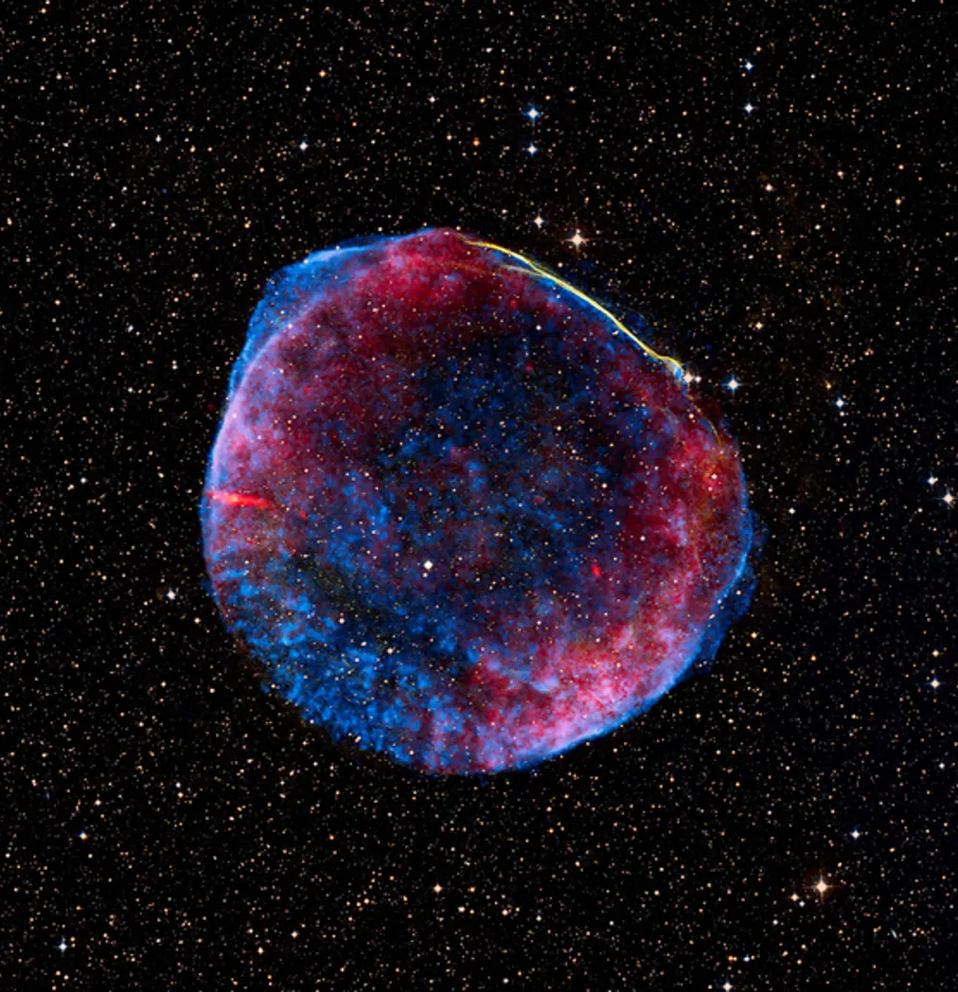
Remnants of a star 7,200 LY away that ended its life as a supernova in 1006

Slide 12
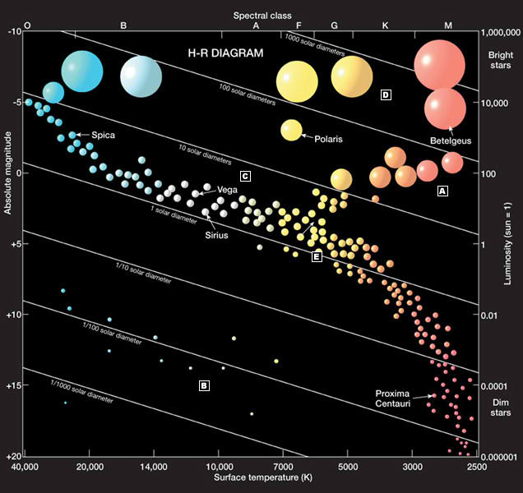
The Herzsprung Russell Diagram (1911)
back

