Slide 1
Uttoxeter U3A - Introduction to Cosmology Session 9 – Stars (2); Lifecycles and especially deaths
A presentation by Dave Thomas
d.t.thomas@staffs.ac.uk
https://davethomaswebspace.org

Slide 2
What we could cover (in 90 minutes or so)
A brief resumé of what’s been mentioned so far
What stars are; generally
How stars form
‘Living’ stars
Different characteristics
Observed colour
Brightness
Size
Spectral signature
Etc
Star lifecycles and deaths (and the Herzsprung Russel diagram)
A quick look forward to next week:
Life in the universe
Your knowledge and questions as we go please

Slide 3
Star formation (birth!)
Stars form from agglomerations of interstellar matter that attract more and more matter by dint of their own gravity
Enabled by ‘Big Bang’ things
This gravity then compresses the agglomerated matter until it is hot enough for nuclear fusion to start (or not) at the core of the star
Different stars ‘shine’ in different ways
Described by Herzsprung and Russel (1911)

Slide 4
Categories of star
‘Mainsequence stars’ of different types:
O (100M☉), B, A, F, G (1M☉), K, M, L (0.1M_{☉)}
Then, towards the end of a star’s life:
Red giants, supergiants and the like (with Prof. Cox),
White dwarves and the like,
Neutron stars
and
Black holes and the like can form.

Slide 5
The end of life of stars
Different stars live and end their lives differently
Massive stars ‘burn’ very hotly, live relatively short lives and finally explode as supernovae to leave ‘remnants’ of:
neutron stars, black holes etc.
Sun-sized stars
Smaller stars
Supernovae are cataclysmic events that leave impressive, observable traces like this and like this, in Keith Jones’s back garden

Slide 6
What we have covered in this session
How stars form
‘Living’ stars and their variety
How stars may die
A quick look forward to next week
Any (further) things? Please let us know and\or share now

Slide 7
Further learning and references
A verbal walkthrough of stellar lifecycles
Back
any (more) knowledge and\or questions?

Slide 8
Next week
‘Life’ in the universe
What is meant by ‘life’
Conditions needed for ‘life’
Probability of conditions being met
Exoplanets
SETI
The Fermi paradox
The Drake Equation and ‘Dark Forest’theory
Etc
back
Back

Slide 9
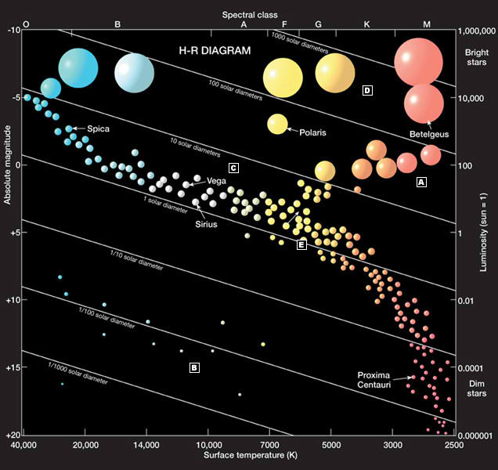
The Herzsprung Russell Diagram (1911)
back

Slide 10
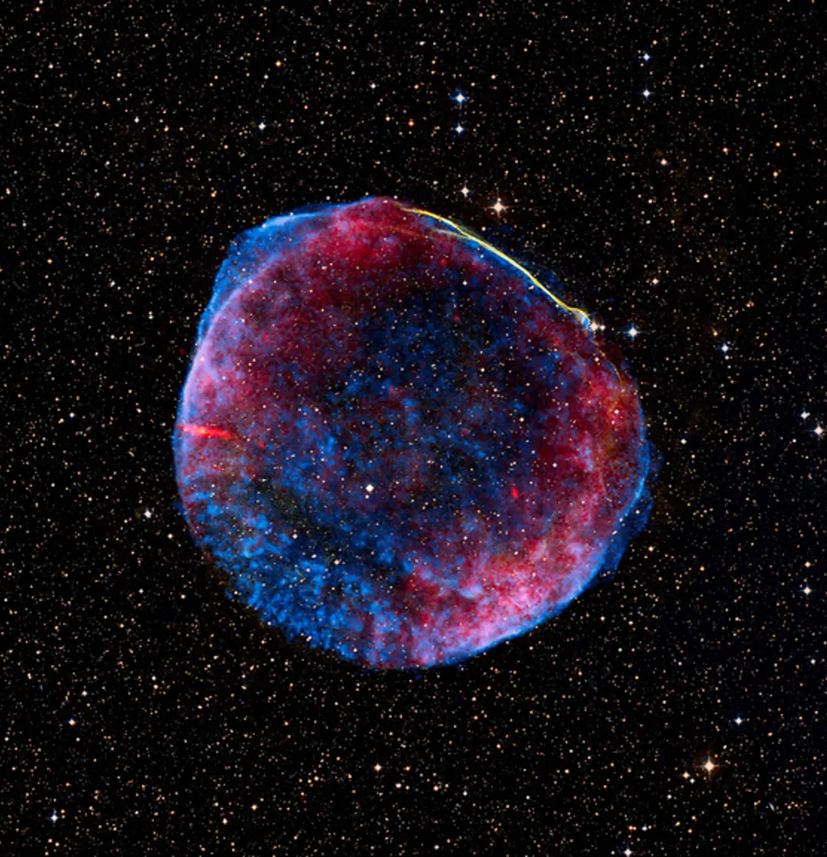
Remnants of a star 7,200 LY away that ended its life as a supernova in 1006
back

Slide 11
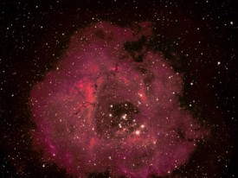
A photo taken by Keith Jones from the U3A Photography group
back

Slide 12
Details of Keith’s photo
This image was taken in my garden at Tean.
It is the Rosette Nebula; 5217 lightyears away and 65 lightyears wide.
It is 90 images of 60 second exposure stacked together to get the detail.
It is situated just to the left of Orion.

