Slide 1
Uttoxeter U3A – Physics Session; The predicted nova in Corona Borealis in 2024
Learning with Dave Thomas
DaveInElderCourt@gmail.com
https://davethomaswebspace.org

Slide 2
What it’s all about
The northern skies look like this
Sometime in the next 6 months, this will change to this
1946 was the last time it happened and previously in: 1877, 1787 . . . . .1217 . . . .
‘It’ is a nova of one of the two stars in a binary system

Slide 3
The final words
Thank you!
It has been fun, so far ☺
We haven’t (yet) considered: stellar formation and evolution, nuclear fusion, photon pressure etc, etc, etc.

Slide 4
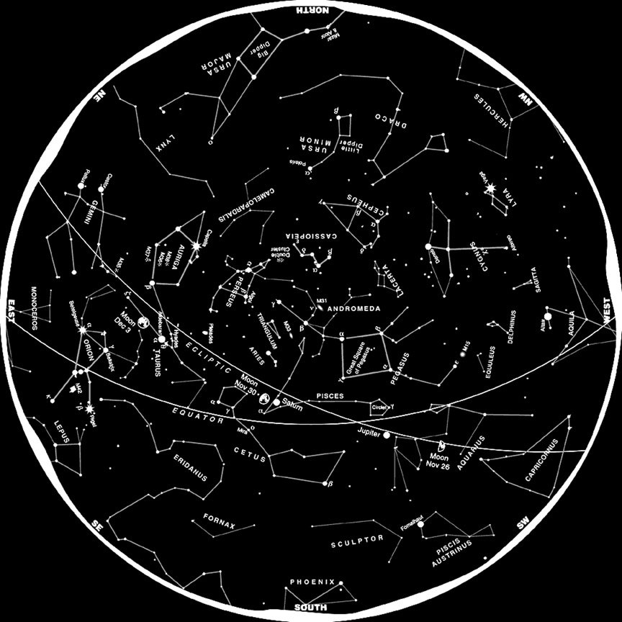
Map of the northern skies
back

Slide 5
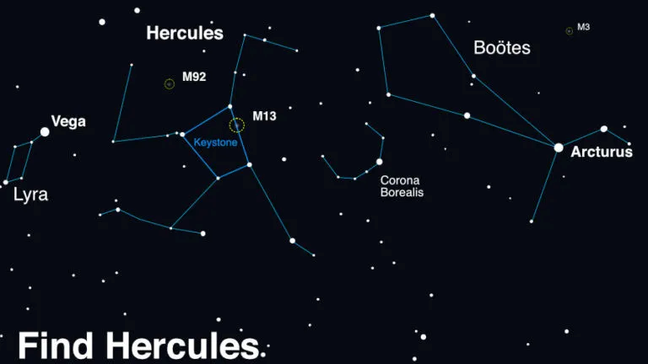
This; T Corona Borealis normally
back

Slide 6
T Coronae Borealis during nova
back

Slide 7
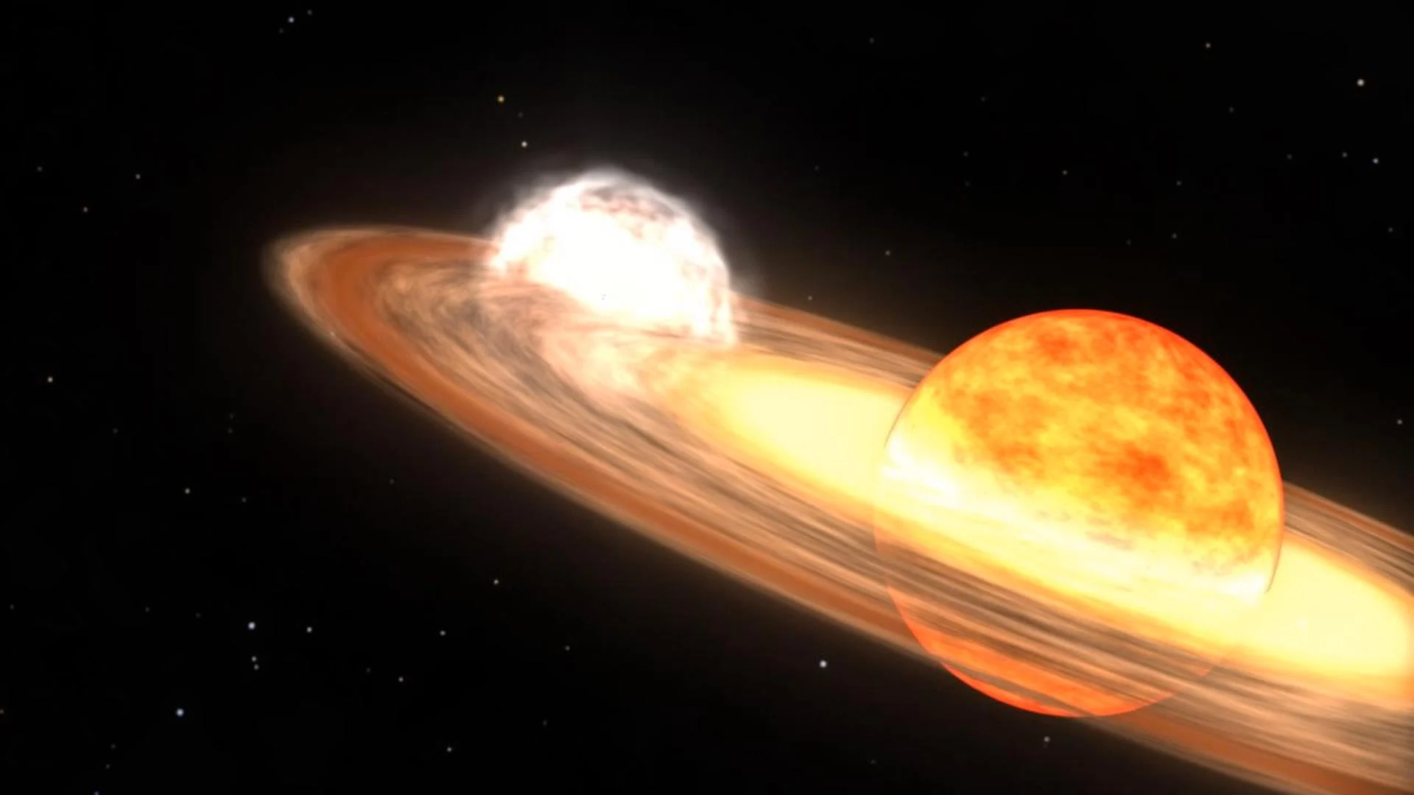
Binary star system
back

Slide 8
A nova, not a supernova
In 2010, Fermi observed a nova event in V407 Cyg but similar to the ‘it’ that’s happening in 2024 in T Coronae Borealis
back

